Slide 1
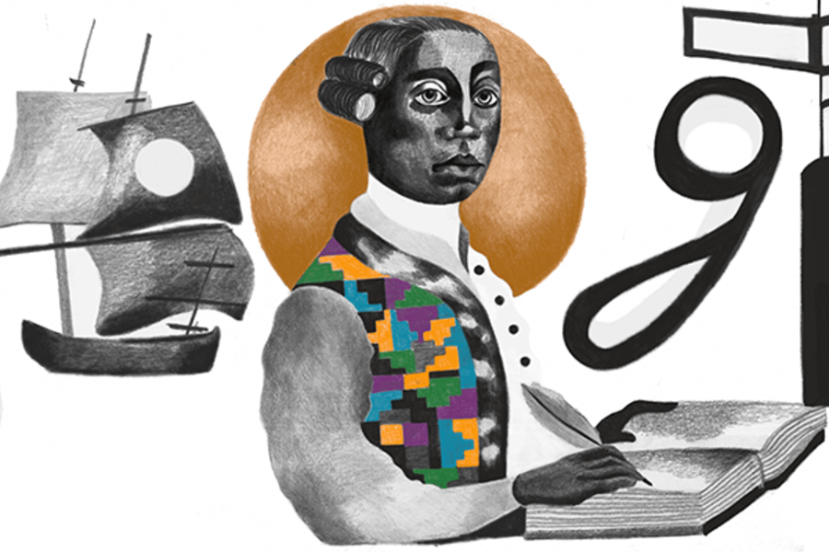
Anton Wilhelm Amo
Stephanie Spoto
Gentrain
Monterey Peninsula College

Slide 2
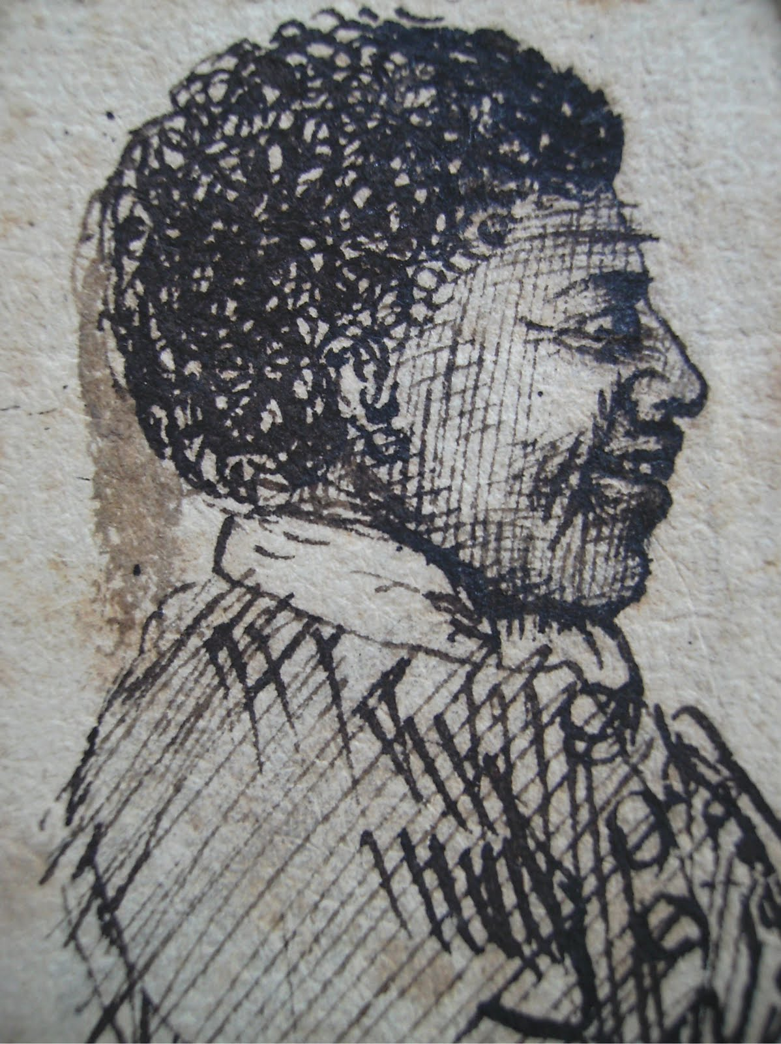
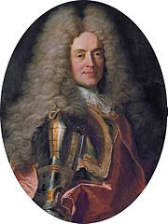
Anton Wilhelm Amo (c.1703-58) early life
Anton Wilhelm Amo: physician and philosopher
Born Axim, Ghana (1703)
Brought to the Netherlands at the age of 3
Dutch West Indies Company was bringing slaves to the Americas, but also charged with spreading Christianity
In 1706, a local preacher in Ghana decided to send a boy, Amo, who had Christian parents to the Netherlands for baptism and education
In 1707, he was given to Duke Anton Alrich of Brunswick-Wolfenbuttel
Dutch West Indies Company quickly replaced the local preacher who had sent Amo to Netherlands, and resumed focus on slave trade

Slide 3
Education and profession
Under the Duke, Amo mastered German, French, Latin, Greek, Dutch, and Hebrew
Duke supported the arts and sciences, wrote hymns, was a theologian
Converted to Catholicism, and this made him a bit of an outcaste
Became adept in medicine, law, and philosophy
Was drawn to the university at Halle for its intellectual freedom and nonconformist faculty for his studies
Professor of philosophy at the universities of Halle, Jena, and Wittenberg
Taught courses in medicine, psychology, cryptology, and other fields
In the middle battles to rescue universities from political and church influence
And in the middle of debates around mechanistic explanations of natural phenomenon

Slide 4
Thesis defense From the university journal of Halle
There resided here for some time an African called Antonius Wilhemus Amo who belonged in the household of His Royal Highness. As he had before then thoroughly mastered the Latin language, he very diligently and with great success studied here in the School of private law. As a result, he became most accomplished in that field. With the knowledge and consent of his patrons, who had maintained him up till that time, he registered with Dean von Ludewig to give a public defense of a dissertation under him. To make the argument of the dissertation appropriate to his status and circumstance, they approved for him the theme “De Jure Maurorum in Europa”: in other words, on the rights of Black Africans in Europe. In it, not only has he shown, basing himself upon Law and History, that African kings were once vassal to the Roman Emperor, and that every one of them had an Imperial Patent, which Justinian, too, had granted, but he especially also examined the question to what extent the freedom or servitude of Africans in Europe, who had been purchased by Christians, accorded with laws commonly accepted at that time.
Halle University journal, 1729

Slide 5
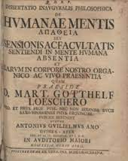
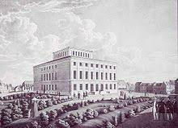
Amo’s two theses
Looking towards religious history, the thesis expounded the crucial contribution of Africa to the development of Christianity → doctrines, practices, and the roll of martyrs
Drawing from secular history, looked to apply the provisions of the Constantinian settlement and the Justinian code to Africa → since African Kings had been vassals of the Roman Emperor
Arguing from both law and history, he concluded that the servitude/slavery of Africans by Europeans, who were Christians, was inflict with commonly accepted laws
Enlightenment argument: Amo makes the bulk of his argument around the inadequacy of Europeans in their adherence to laws (rather than making an argument about morality)
Had anti-clerical and anti-establishment contentions → caused a stir which likely led to the abstract in the university journal
Also led to Amo leaving Halle in 1729 → directed by his advisor Ludewig to seek refuge at nearby Wittenberg University (under the guidance of his friend Gotthelf Loescher).
It was at Wittenberg that Amo received his degrees and title of Doctor in Philosophy
Loescher chaired Amo’s successful defense of his second thesis: Of the Apatheia of the Human Mind, namely, the absence of sensation and the faculty of sense in the Human Mind and their Presence in our Organic and Living Body

Slide 6
Response by Loescher
We proclaim Africa and its region Guinea, separated by a very great distance from us, and formerly the Gold Coast, so called by Europeans on account of its abundant and copious yield of gold, but known by us as our fatherland, in which you first saw the light of day, the mother not only of many good things and treasures of nature but also of the most auspicious minds: we proclaim her quite deservedly! Among these auspicious minds, your genius stands out particularly, most noble and most distinguished Sir, seeing that you have excellently demonstrated felicity and superiority of genius, solidity, and refinement of learning and teaching, in countless examples before now, and even in this our University, with great honor in all worthy things, and now also in your present dissertation.
I return to you still intact, and absolutely unchanged in any respect, that which you have conscientiously and with elegance worked out, supported by your erudition, in order that the power of your intellect may shine forth henceforth all the more strongly.

Slide 7
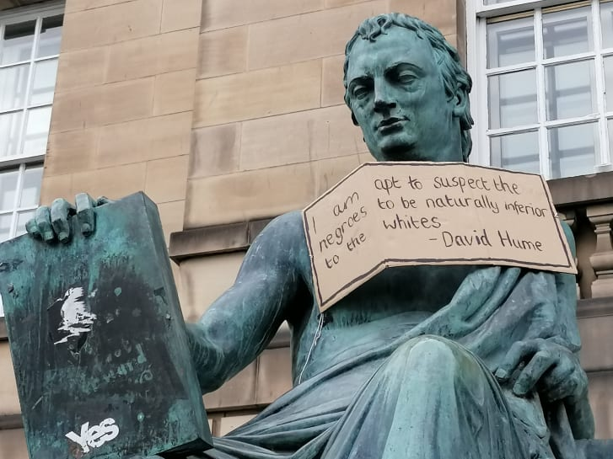
I am apt to suspect the negroes, and in general all the other species of men (for there are four or five different kinds) to be naturally inferior to the whites. There never was a civilized nation of any other complexion than white, nor even any individual eminent either in action or speculation. No ingenious manufactures amongst them, no arts, no sciences. On the other hand, the most rude and barbarous of the whites, such as the ancient GERMANS, the present TARTARS, have still something eminent about them, in their valour, form of government, or some other particular. Such a uniform and constant difference could not happen, in so many countries and ages, if nature had not made an original distinction betwixt these breeds of men. Not to mention our colonies, there are NEGROE slaves dispersed all over EUROPE, of which none ever discovered any symptom of ingenuity; tho’ low people, without education, will start up amongst us, and distinguish themselves in every profession. In JAMAICA, indeed, they talk of one negroe as a man of parts and learning; but ’tis likely he is admired for very slender accomplishments, like a parrot, who speaks a few words plainly.
David Hume, ‘Of National Characters’ (1753 edition)

Slide 8
Descartes’s dualism
Dissertation on the subject of dualism → appealing to this position to try to clarify the relationship between body and mind (claimed that Descartes’s position was inconsistent and confused)
Descartes: ontological dualism made mind and body subject to comparable principles and concepts of explanation
Mind: non extended-substance, who essence was to think
Body: non-thinking substance who essence was to be extended
Not every action on us results in thought or cognition → sensation is then conceived as the basic link between mind and external world
Thought to happen through transference, penetration, or immediate contact
Descartes claimed that the human mind was always active (not ever passive)
Amo: Therefore, inconsistent to ascribe to it a feature like sensation, which would require it to be both passive and extended

Slide 9
Amo responds to Descartes
Amo: Descartes’s formulation is confused → Descartes claims that the function of an organ is to receive sensible forms (through feeling) and then to judge the forms when received (through taking cognizance of what is felt
However, taking stock of bodily pain or bodily contact should not require the mind itself to feel pain or contact → does not need to sense anything whatsoever
Sense faculty is not an apposite feature of minds → it is not necessary in that use or circumstance
Amo: denies that the mind can feel → sense organs are only a medium (not an instrument)
In this, there would be no sensing without sense organs → the faculty of sense is the body, not the mind
The mind (res cogitans) does not feel or sense material things → feeling happens through the body (res extensa) which is passive material
This made Amo more of a dualist than Descartes
Dwight Lewis: “For Descartes, the mind and body, which are distinct substances, interact and commingle at the pineal gland, producing the passions of the soul. Amo responds with a “No.” For Amo, ontologically distinct substances are necessarily distinct. Consequently, sensing necessarily belongs to the body because without a body, one cannot sense. There is an impassivity between the mind and sensation because the mind is immaterial and sensations necessarily need to occur upon something passive and material (the body), which means sensations could only ever be cognized through and occur on the body.”

Slide 10
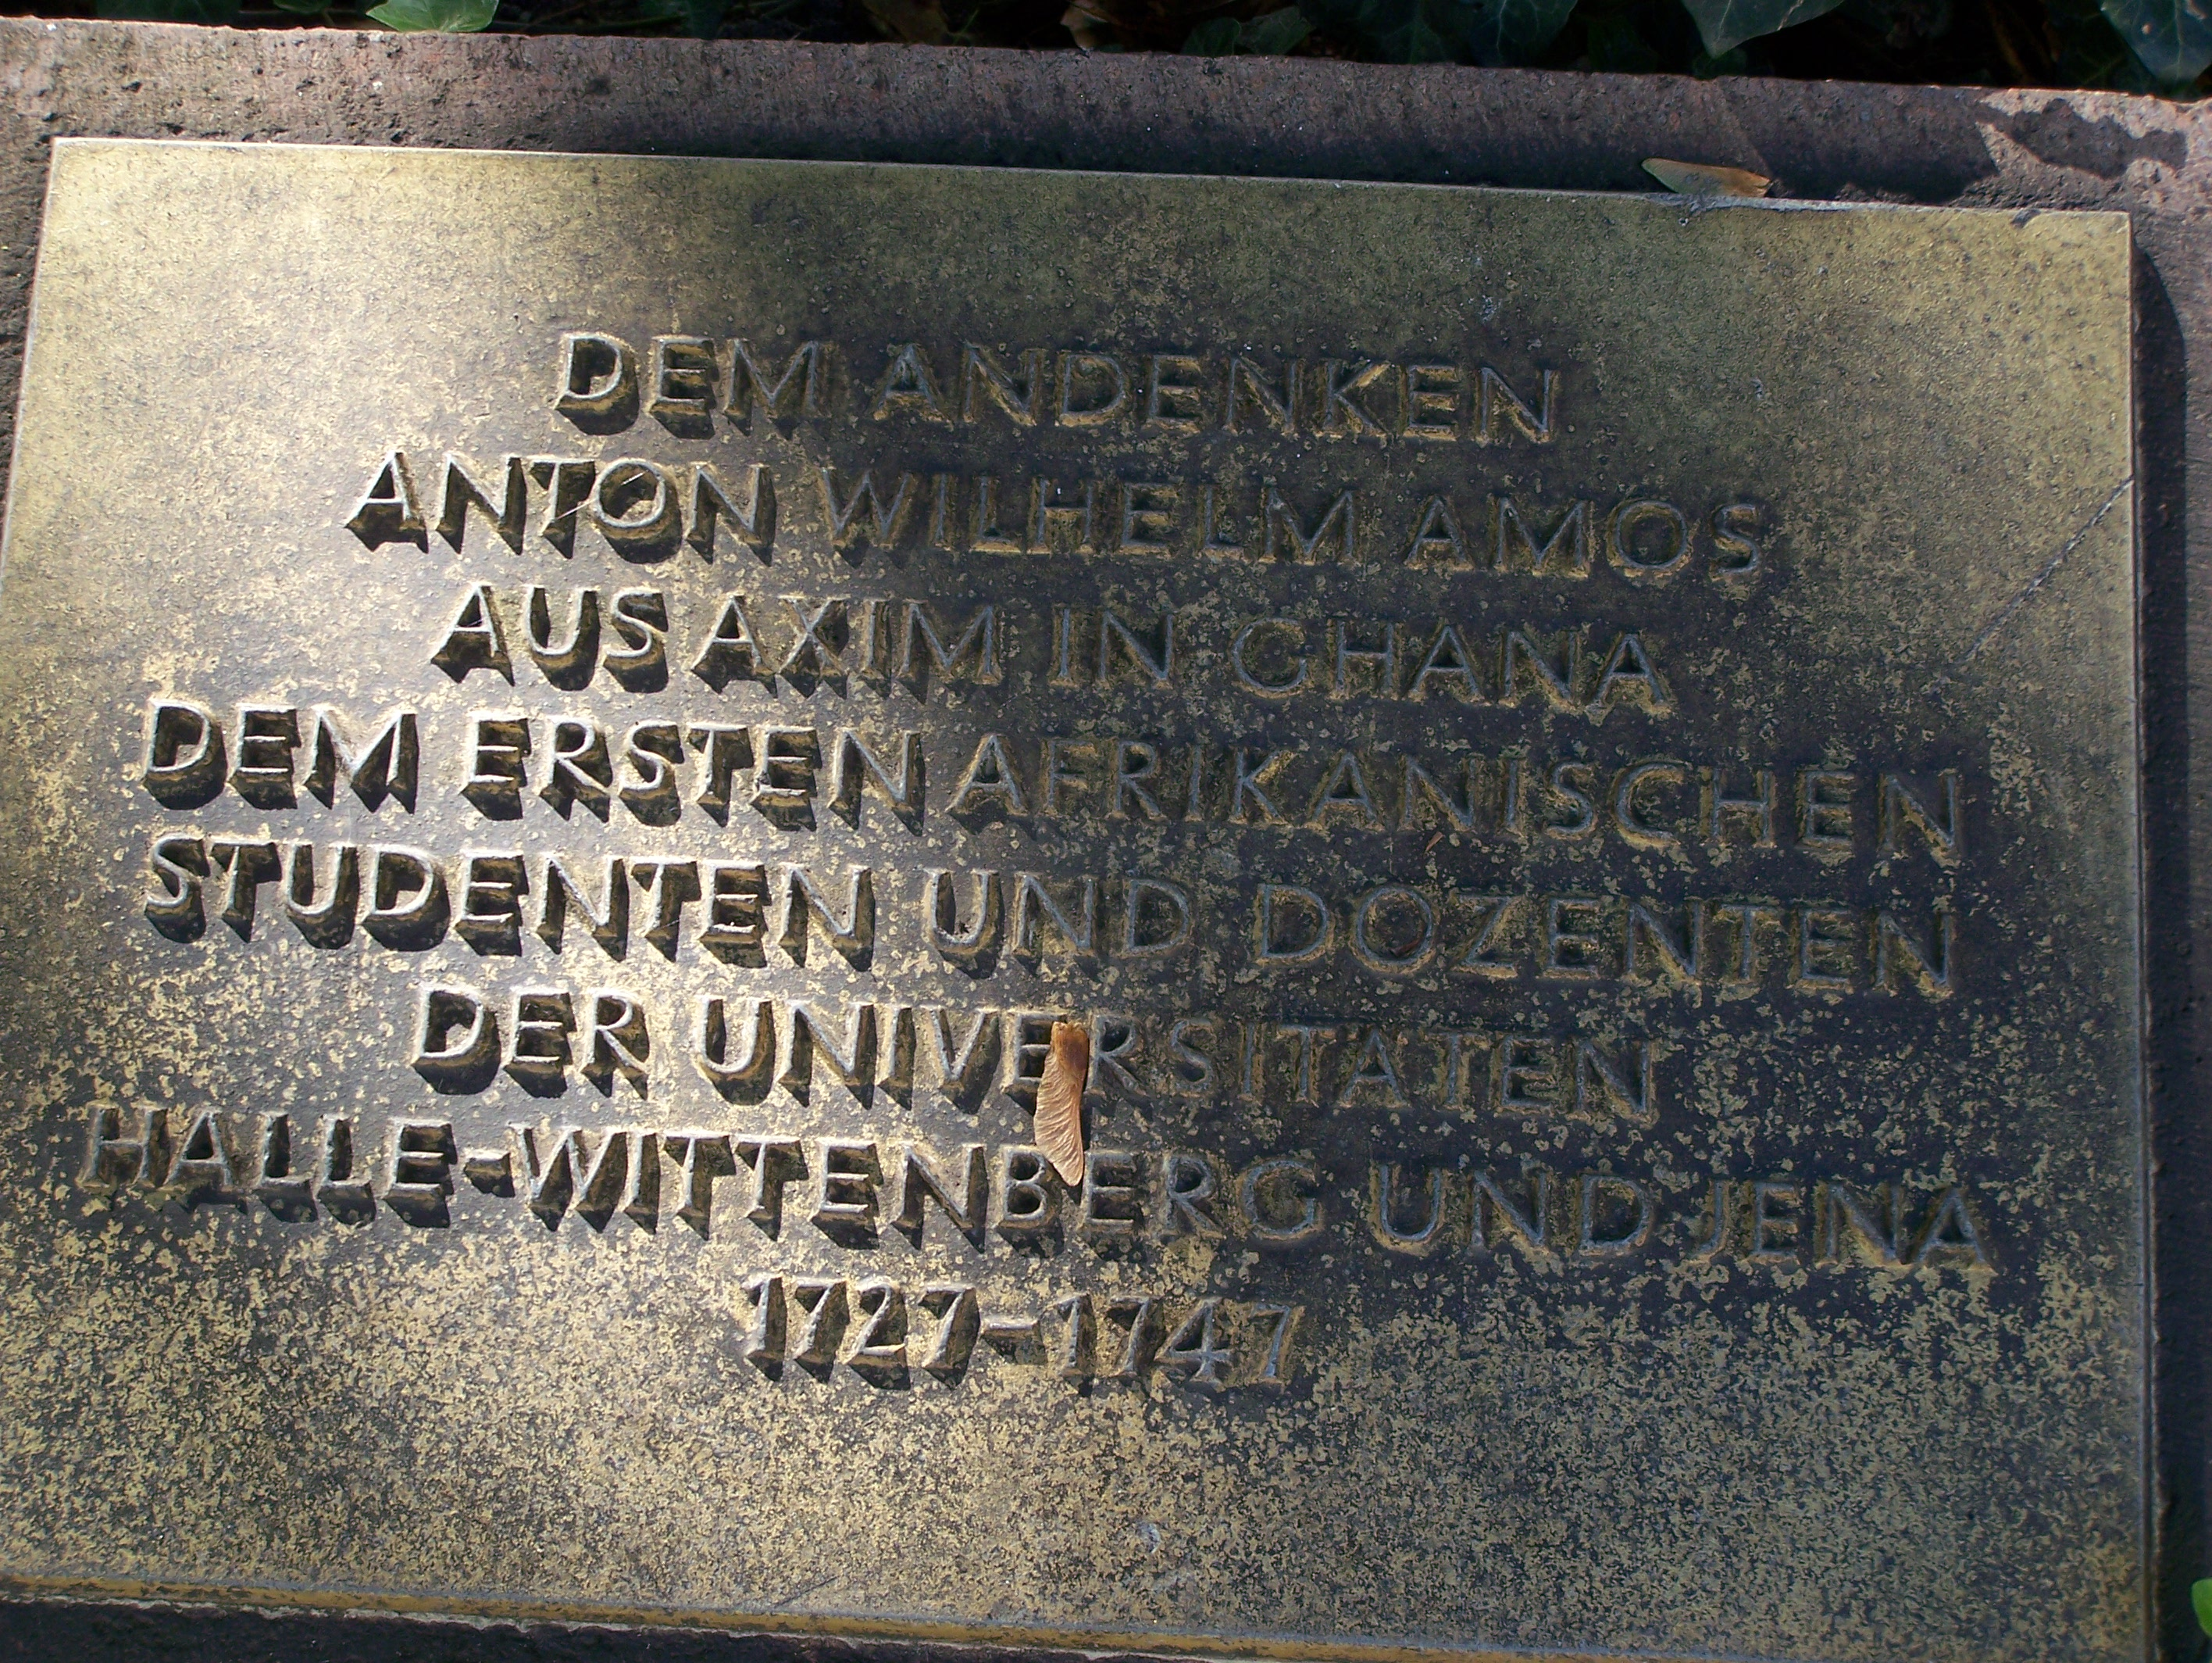
Whatever feels, lives; whatever lives, depends on nourishment; whatever lives and depends on nourishment grows; whatever is of this nature is in the end resolved into its basic principles; whatever comes to be resolved into its basic principles is a complex; every complex has its constituent parts; whatever this is true of is a divisible body. If therefore the human mind feels, it follows that it is a divisible body.
Anton Wilhelm Amo

Slide 11
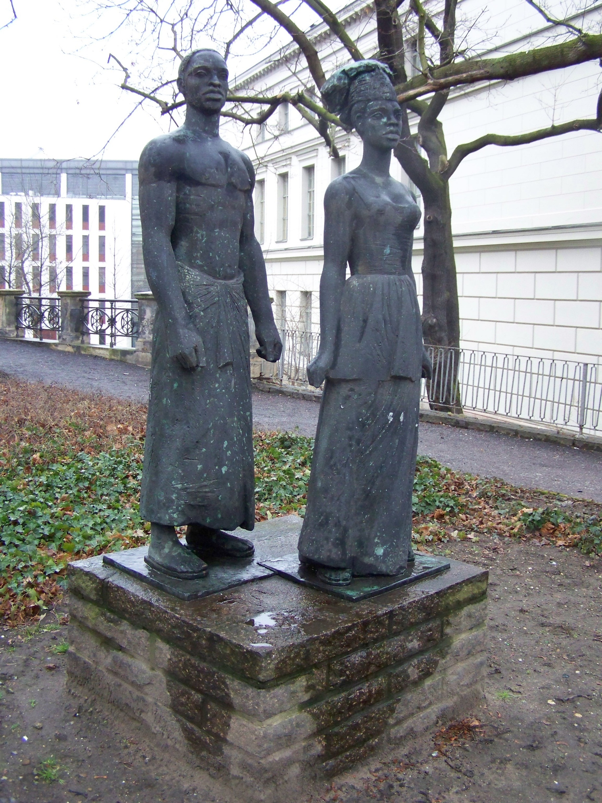
Publications and financial trouble
University of Halle: Amo gave lectures on Leibniz, Christian Wolff, and on the philosophy of law
Write a book De Arte Sobrie et Accurate Philosophandi (“On the Art of Sober and Accurate Philosophising”), 1738.
Translations in German, and Russian
Advocated for mechanistic view of the body → work angered clericals and pushed him to leave another university and went to Jena
Though one of the most brilliant philosophers at any of these universities, his financial situation was getting worse
Was forced to mention this in his appeal to the university, requesting permission to give public lectures:
Following a practice of doing good service for the state, pricked on by the sharp dart of poverty (for I have a poor home), I have, to the best of my ability, been teaching philosophy at home in both the universities of Wittenberg and Halle, and have quite often engaged in public disputation, and have performed these tasks with diligence. Therefore, you, gentlemen of outstanding reputation in the world of letters, I hope that you will pay the same attention to me in this, your famous seat of the Muses. Once you have kindly shown me this indulgence, I shall thank you for your action, and shall never grow tired of praying to heaven that you, my excellent patron, may enjoy forever a most desirable happiness.
Antonius Guilielmus Amo Afer, Philos, et art. liberal. Magister legens et. Jur. cand.” (Halle, 27 June 1739)

Slide 12
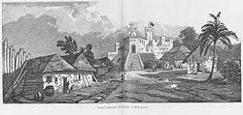
Return to Ghana
Several things came together to induce Amo to leave Europe:
He fell in love with a fellow student and was rejected (whether this is true or not is uncertain – part of a satirical article which made fun of Amo), article dated 1747
Financial hardships
Death of his supervisor and friend Ludewig (1743)
Universities becoming less liberal and more intellectually narrow
People arguing against the secularization of education were gaining ascendency over people who argued for intellectual freedom (like Christian Wolff)
Returned to Ghana → father and sister still there
records become more obscure: but one account has him taken prisoner in a Dutch fortress, Fort San Sebastian in Shama (c. 1750) to stop him from fomenting dissent
Likely this is where he died

